Slide 1
The Sales Process

Slide 2
Closing the Sale

Slide 3
Overview
What is the Close?
When to Close
Basic Closing Strategies
Specific Closing Techniques
Finishing Up

Slide 4
Words to Watch
The Close
Incremental Closing
Direct Close
Summary Close
Routine Assumption
Command Assumption
Dramatized Assumption
Action Assumption
Special Features Close

Slide 5
What is a Close?

Slide 6
What is the “Close?”
Close – (v) to unite; to reach an agreement.
Closing in the sales process can have two meanings:
Asking for the ________
Coming to agreement on next steps
Asking for the order transforms prospects into customers
In a business to business sales process, next steps arrange for progress toward asking for the business

Slide 7
What is the “Close?”
No sales call can be successful without a successful close
Believe it or not, many salespeople _____ to ask for the order
They’re excited about the product
They can’t imagine the customer not asking to buy
Closing capitalizes on each step of the strategic selling process to move the customer toward action

Slide 8
Asking for the Order
Asking for the order can seem difficult
This is the “moment of truth”. . . the time when you find out if you succeeded or failed
Many salespeople have difficulty closing because they are afraid of rejection
The only way to be certain a customer will say “yes” is to ask them

Slide 9
Asking for the Order
The value structure of many salespeople makes “asking for money” distasteful and that is how they perceive closing
The only way for your customer to gain the benefits you offer is when you _______ successfully
In fact, if you fail to close successfully your customer will not gain the benefits that you believe strongly are possible and it will be your fault

Slide 10
Asking for the Order
Consider that . . .
The customer has spent time with you
The customer agreed to work with you to find a “best” solution
They have given you information or talked with you about their satisfaction with past solutions
So, why wouldn’t they ________you to ask them for their business?

Slide 11
Closing
Lend them your confidence!
Closing is a time to show confidence and a very positive attitude
Be ___________
The difference between “pushy” and “assertive” in the “tact” you use
It is far more common for salespeople to err on the side of too little aggressiveness rather than too much

Slide 12
When to Close

Slide 13
When to Close
Close whenever the prospect is ready to buy!
It is easy to ___________
Many salespeople, feel compelled to tell “the whole story” before closing
They may actually talk themselves out of a sale
“Never bore a buying customer”
When the prospect has sufficient information to make an informed decisions
…CLOSE!

Slide 14
When to Close
Customer:
“I’ve been thinking, and I like this idea.”
Salesperson:
“But wait, I haven’t told you about…”
“Great, but let me show you this special feature…”
“Well, I thought you might want to try a small plot first...“

Slide 15
Verbal Buying Signals
By tuning in to the customer, the salesperson can identify when it is time to close
One _______ is when the customer is doing almost as much of the talking as the salesperson
Another clue is when the customer begins talking about steps that would ordinarily take place after they buy
Delivery, Training, or Financing, for example.

Slide 16
Verbal Buying Signals
Verbal buying signals often occur
After getting agreement on a key benefit
After handling a key ____________ well
When the customer asks about the warranty
When do you “know” the customer is ready?
You never “know,” until you ask…
but experience is a great teacher

Slide 17
Communication Styles
Part of knowing when to close will depend on the buyer’s communication style
High D’s may want to move to a decision very quickly and prefer a direct question
High I’s may appreciate your review of their situation
High S’s may like something routine
High C’s may want you to spend more time on details

Slide 18
Non-Verbal Buying Signals
Non-verbal signals are important to understanding where the customer is in the buying process
Sitting up -- leaning toward you
Frequent, solid eye contact
Smiling - enjoying what they are hearing
Arms open, palms up, accepting
Rubbing hands together
Making calculations or notes
Enthusiastic _______________

Slide 19
Non-Verbal Buying Signals
Look for “clusters” of clues
Paul Nobbe, Laura’s Lean Beef

Slide 20
Trial Close
If you’re unsure about the buying signals you get, use a trial close
“How does that sound so far?”
A negative response doesn’t mean the process has ended
A positive response may mean you need to move toward a more specific close
Or even begin to complete the order!

Slide 21
Trial Close

Slide 22
Closing Strategies

Slide 23
Incremental Closing
Incremental closing is not the ABC approach (_________________) in the sense of constantly asking for an order
An incremental close in a business to business sale simply recognizes that there are many steps in the sales process
Permission to move forward is needed at each step.

Slide 24
Incremental Closing
Each stage of the decision process may require a close
Agreement that you are addressing the right need
Agreement about the product features that will satisfy the need
Agreement that they will benefit from the features
Agreement that the recommendation is the right one
Agreement to buy

Slide 25
How Not to Close A Sale
Closing is a time to show ___________in your solution
Never - Never – Never start a close by stating their objection
“I know you really like your current supplier, but…”
“You probably don’t want to buy any today, but….”
“I know we’re higher priced, but would you consider…”

Slide 26
Specific Closing Techniques

Slide 27
5 Techniques to Close
There is no “one best technique” to get commitment, but several “classics” include:
The direct close
The summary close
The choice close
The assume close
The special features close

Slide 28
1. The Direct Close
Simply ____ the customer for their business.
“Gloria, we’d like to do business with you. How about giving us a chance to show what we can do?”
Works well when . . .
The sales relationship is open and positive
The salesperson has just handled a difficult _____________
The salesperson and customer have a long-standing relationship

Slide 29
Direct Close

Slide 30
2. The Summary Close
Briefly summarize the ______________made, including benefits to the customer and address any major concerns the prospect may have had
List their concerns and key needs
Ask them if there are any other issues
List the positive results of the solution
Review the list
Ask for a favorable ___________

Slide 31
2. The Summary Close
The summary close works particularly well…
With _________salespeople
With complex purchases
When the salesperson is proposing a solution to a complex problem
When the customer will have to make adjustments to take advantage of your solution
With customers who are analytical

Slide 32
3. The Choice Close
Offer the customer a ______choice - an easy choice -but not the choice between buying and not buying
“Would the standard or the deluxe model work best?”
“Would you prefer cash or credit?”
“Which day of the week do you prefer?”
The choices the salesperson offers should be drawn from interests the customer has expressed

Slide 33
3. The Choice Close
The salesperson essentially sets up a choice between buying and buying
Either choice is a commitment to buy
The choice close is a very strong technique because it expresses confidence that the customer will buy
Works well when the buyer and salesperson know each other well and there is a level of trust established

Slide 34
4. The Assumed Close
Do not ask for the order but assume they are ready to buy and move ahead with the details
On the surface this sounds presumptive and even arrogant
But in a strong relationship it may just be a normal progression
It works best with current ________ customers or when the prospect has made it clear they are excited about the idea

Slide 35
Assumed Close

Slide 36
4. The Assumed Close
There are two guidelines that apply to the Assumed Close:
Always make sure the prospect ____________ that they made a purchase (Surprises later are very bad)!
Be particularly alert to resistance (verbal or non-verbal) as you move ahead

Slide 37
4. The Assumed Close
There are four types of assumed closes:
___________ assumption -
Sketch out your next step and go ahead
“Great! I’ll stop by tomorrow and begin sampling!”

Slide 38
4. The Assumed Close
____________ assumption -
Tell the prospect what they need and get started
“You’ll need about three boxes to get you started. I’ll get it shipped out yet today.”

Slide 39
Command Assumption

Slide 40
4. The Assume Close
____________assumption -
Paint a positive picture of the future solution
“You are really going to enjoy the convenience of those doors.”

Slide 41
4. The Assume Close
Action assumption
Say __________ - Just begin sketching field patterns or finalizing paperwork for their signature
Responsive: The customer is busy and this is a standard rebuy
Manipulative: He who speaks first loses.

Slide 42
5. Special Features Close
Add something extra - a small discount, an extra service
With some customers, especially those who pride themselves on being good negotiators, this can “tip the scales” and make the sale
Works well with loyal customers
When you let a long-standing customer know about a special deal that will benefit them you can often close the sale quickly

Slide 43
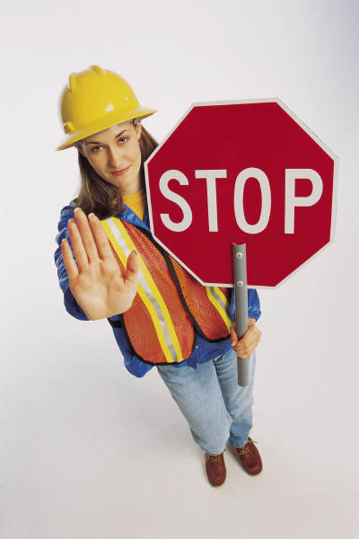
5. Special Features Close
Two cautions using the “special features” close. . .
Use of this close may “train” the customer to always __________ a “special deal” from you
Some types of buyers may resent this approach. They may feel manipulated and that you offer different “deals” to different people

Slide 44
Finishing Up

Slide 45
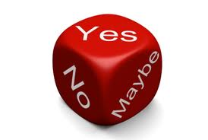
After They Say “Yes”
Immediately after a customer says “YES” there are several things that become important
_______ them
Reinforce the decision
Clarify next steps
Manage expectations

Slide 46
Thank Them
It’s an easy step to forget in the detail of writing contracts

Slide 47
Reinforce the Customer’s Choice
Immediately after saying “yes,” customers may begin to ask themselves . . .
Did I really need that product or service?
Did I need to buy it now?
Did I pay too much?
Will this product really meet my needs?

Slide 48
Reinforce the Customer’s Choice
Many customers experience second thoughts
This is called post-purchase dissonance
Post-purchase dissonance or buyer’s ___________ usually happens after you have left them
There is little you can do about it except to give the customer a call a few days and ask if they have any additional questions and reinforce their decision

Slide 49
Clarify Next Steps
It has been said . . .
“Discontent is relative to expectations”
Expectations can be managed with only a little effort by the salesperson
Set expectations in three areas:
What the product will do and how to measure performance
What you will do to follow up
What the customer should expect from your company

Slide 50
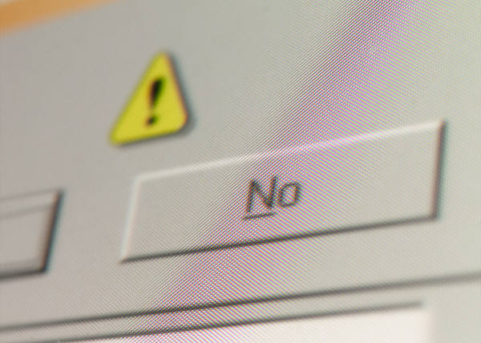
What If they Say, “No.”
No one likes to be turned down
It is difficult not to take rejection personally
Remember -- When the customer says, “No”
They are saying “No” to your product, not to you
They are not saying “No” forever
They are just saying ______________

Slide 51
What If they Say, “No.”
Leave the door open for future business
Their circumstance may change
They may change employers
If you’ve done a particularly good job in working with them
Ask them for a referral
In all cases, ____________, and thank them for the opportunity to get to know them
If there could be a future opportunity, set a date to get together again

Slide 52
Summary

Slide 53
Summary
Closing is the “moment of truth”
But also incremental agreement to move forward in the sales process
There are many choices for “How” to close
The right one depends on the relationship and situation

