Slide 1
The Sales Process

Slide 2
Customer Satisfaction and Follow Up

Slide 3
Overview
Customer Satisfaction
Managing Touchpoints
Measuring and Monitoring
Managing Complaints

Slide 4
Words to Watch
Competitive Advantage
Channel Level
Touchpoints
Value Chain Linkages

Slide 5
Customer Satisfaction

Slide 6
Customer Satisfaction
Customers buy on the basis of perceived value
Actual value is not received until
_____ the purchase decision
Customers logically make a comparison
between perceived and actual value

Slide 7
Customer Satisfaction

Slide 8
Customer Satisfaction
Following a purchase decision a customer’s perceptions turn into expectations
Expectations for product performance
Expectations for service
Expectations for information and support
Perceptions and expectations are not formed solely with input from the salesperson

Slide 9
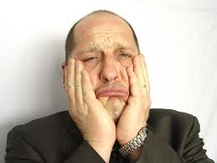
Customer Satisfaction
The value a customer receives is judged on the bases of two primary factors
What the customer ______have received from other alternatives in the marketplace
What has been promised by the salesperson

Slide 10
Marketplace-Driven Expectations
Companies communicate their competitive advantages
Competitive advantages are often fleeting because successful advantages are copied by competitors
However, value created by the salesperson is harder to ___________

Slide 11
Marketplace-Driven Expectations
Customers often form their expectations based on what is available in the market
In order to meet or exceed those, salespeople must __________what expectations customers hold
In addition to shaping perceptions of value, salespeople must also deliver on them

Slide 12
Marketplace-Driven Expectations
Customers often expect:
Delivery
Training
Answers to questions
Technical support
Purchase incentives for bulk orders

Slide 13
Marketplace-Driven Expectations
General expectations are not as valuable as your customer’s ________ expectations
Don’t assume you know what they expect
They change over time
Things change between meetings
It’s always best to ask what they expect

Slide 14
Marketplace-Driven Expectations
Understanding expectations offers you the opportunity to
Sell something different than they may have considered
Sell _____ than they may have considered
For example: Understanding expectations on delivery times allows you to be seen as more responsive by exceeding them

Slide 15
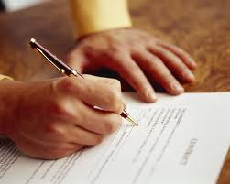
Sales Driven Expectations
Salespeople make both explicit and implicit promises
Explicit are those that are stated
Implicit are those that are implied
____ create expectations on what will be delivered to the customer

Slide 16
Sales Driven Expectations
Explicit promises must be delivered on
Implicit promises are less clear
These aren’t promises in the sense that there is a contractual obligation to perform
But, in the customer’s mind
A promise is a promise

Slide 17
Sales Driven Expectations
Satisfaction may be determined based on delivery on both types of promises
Therefore, a discussion that clearly __________customer expectations is key
In line with the communication style of the buyer
Spend less time with D’s
Spend more time with I’s
Make sure S’s are comfortable
Make sure promises are written for C’s

Slide 18
Sales Driven Expectations
“Service” is often a ________ about how well the salesperson has delivered compared to expectations
Therefore, a salesperson continually manages expectations
Even after the sale!

Slide 19
Four Levels of Satisfaction
There are four aspects of satisfaction that the salesperson has ___________
Quality of sales calls
Customer value added through the sales process
Implementing co-created solutions
Benefits to the customer’s business

Slide 20
Sales Call Quality
Every call should have an objective
Every call should have an _________
Every call should help build trust
Every call should bring value
Customers expect that each interaction with a professional salesperson is worth their investment of time

Slide 21
Sales Call Quality
You can evaluate the quality of your sales calls by:
Taking the time to ________
Being honest with yourself
Consistently asking questions
How did it go
Where do we want to get to next time
What can we do better to get there
Note that these follow a strategic analysis format!

Slide 22
Value through the Sales Process
Every call should leave the customer with something worthwhile
Not a brochure
Not a hat
But _________that will help them move toward a business goal,
at least in some small way

Slide 23
Value through the Sales Process
“Customers are so busy today that a salesperson must plan to take enough value on each call that a customer is willing to take out a checkbook and write the salesperson a check for the value that customer received.”
-- Neil Rackham

Slide 24
Value through the Sales Process
Evaluating the value you bring through the sales process requires looking at the customer’s behavior and your own
Have they learned anything?
What behavior tells you that they have or have not?
Have you brought them anything beyond product information?
Have you been formal in your planning?

Slide 25
Implementing Solutions
Salespeople must deliver on promises made
________________________________
With both service and product performance
Did you meet the objectives?
Does the customer have the capability and skills to implement the solutions?
Is the customer on track with implementation?

Slide 26
Receiving Business Benefits
The best outcome is when customers perceive that they are receiving the benefits promised from the features they purchased,
but how do you know what they perceive?

Slide 27
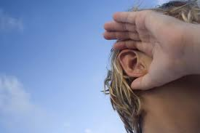
Receiving Business Benefits
How do you know what a customer perceives?
Perceptions change over time, and satisfaction must be monitored
Evaluate yourself throughout the sales cycle and at its conclusion
ASK!
ASK
AGAIN!

Slide 28
Managing Touchpoints

Slide 29
Managing Touchpoints
Touchpoints are any place that your customer _____________your company
Products
Services
Billing
Marketing
Customer service
Comments from friends
Comments form competitors

Slide 30
Managing Touchpoints
Some touchpoints are controllable
Billing
Some touchpoints are uncontrollable
Comments from friends
Some touchpoints are dealbreakers
Good customer service
Some are just nuisances
Dirty trucks

Slide 31
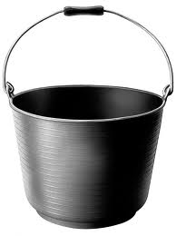
Managing Touchpoints
Touchpoints
Touchpoints
Good and bad touchpoints add up over time until one ___________
Bad
Good

Slide 32
Creating Value Chain Linkages Requires Management
Human Resource Mgmt.
Human Resource Mgmt.
Financing
Financing
Service & Technical Support
Sales
Distribution
Inventory Holding
Production
Research
Logistics
Marketing
Inventory Holding
Production
Purchasing
Seller
Buyer

Slide 33
Managing Value Chain Linkages
There are often many linkages, and perceptions may not be ________
A salesperson can have better management of touchpoints by:
Making sure everyone knows about important accounts
Getting by-in from organizational leaders
Leading from the middle, working up and down in the organization

Slide 34
Measuring and Monitoring

Slide 35
Measuring and Monitoring
Salespeople can know when a bucket may boil over by staying in tune with customer perceptions
Setting specific times to measure
Involving third parties to measure
Administering periodic surveys
Conducting annual account reviews

Slide 36
Measuring Satisfaction

Slide 37
Measuring and Monitoring
Results of measuring can be reported along a continuum from
Dissatisfied Delighted

Slide 38
Managing Complaints

Slide 39
Some Companies Seek out Complaints

Slide 40
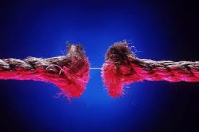
Managing Complaints
Often if customers are dissatisfied they will complain
Some complaints are temporary nuisances or transactional dissatisfaction called a __________complaint
__________ complaints are more serious
Repeated problems
Relationship concerns
Areas of concern beyond the salesperson’s control

Slide 41
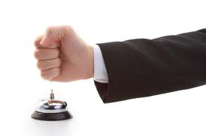
Managing Complaints
Complaints often have emotions attached to them
Complaints are somewhat like objections and are handled similarly
Recognize
__________
Resolve

Slide 42
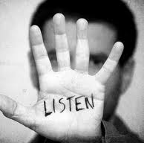
Recognize
Whether the complaint is a list of grievances
Or just the result of a _________
The first step is to listen and recognize the customer’s concerns
Remain calm
Listen without being defensive
Empathize
Ask fact questions in order to understand better

Slide 43
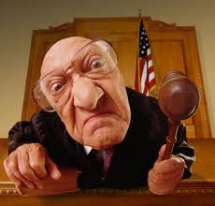
Respond
There are many considerations when dealing with complaints
Legal obligations
Moral obligations
Consequences and costs
of taking responsibility
Consequences and costs of
NOT taking responsibility

Slide 44
Respond
Determining who is at fault is only one consideration
And for minor issues may not even be important
Sometimes the salesperson has authority to respond adequately to a complaint
This is often true with _______complaints
Sometimes a supervisor must be involved or at least informed

Slide 45
Resolve
Responding to the concern does not mean the problem is resolved
Resolution requires a _________ from the customer to say its resolved
Keep in mind that the complaint results in a new set of perceptions for the customer
A new set of expectations
And satisfaction must be monitored

Slide 46
Summary

Slide 47
Summary
Customer satisfaction can make or break a salesperson’s success
Customers assess performance relative to a set of expectations
Some aspects of performance are within the control of salespeople, some are beyond
Measuring satisfaction and dealing with customer complaints are necessary skills for salespeople

