Slide 1
The Sales Process

Slide 2


Tools and Tips from the
“Best of the Best” Sales Professionals
Best
of the
Best

Slide 3
Overview
Best of the Best
Networking
Elevator Speeches
Time Management
Account Profiles and Customer Data
Call Plans
Call Reports
Forecasting
Working through Others

Slide 4
Words to Watch
Networking
Network Linkages
Philanthropic Activities
Service Organizations
Elevator Speech
Customer Relationship Management
Call Plan
Agenda
Call Report
Leadership

Slide 5
Best of the Best

Slide 6
Best of the Best
Best
of the
Best
The best of the best have three fundamental traits:
  Technical Knowledge
  _______________
  Selling Skills
Best of the Best
Technical
Selling
Business

Slide 7

Best of the Best
Best
of the
Best
These traits are demonstrated in sales interactions with customers
  But also in activities that support the sales process

Slide 8
Networking

Slide 9
Networking
Best
of the
Best
A five step process
  Link with decision makers in the industry
  Establish ____________ as a professional
  Influence others positively
  Increase contacts in other industries
  Share resources with others

Slide 10
__________________.
The results of Stanley Milgram’s “Small World” experiment on social connectedness are often summarized as showing that “six degrees of separation” exist between any two humans on the planet.
Facebook experiments conducted by the University of Milan in 2008 showed the number was 5.28 connections, and in 2011, was 4.74.

Slide 11
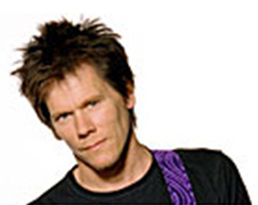
Network Linkages
Best
of the
Best
The Kevin Bacon Game was created by students at Albright College soon after
In a January 1994 Premiere magazine interview about the film, “The River Wild,” Kevin Bacon commented that he had worked with everybody in Hollywood or someone who's worked with them.

Slide 12
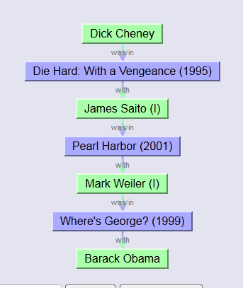
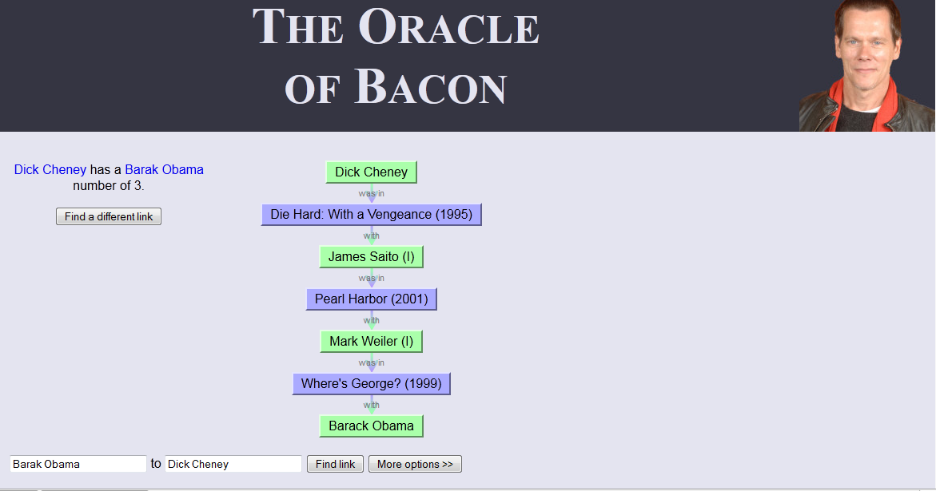
Network Linkages

Slide 13
Network Linkages
You
Using your network effectively means planning for how to ___________any potential prospect
Through your connections with others
Are roommates with
Tom
Whose mother is
Laura
Whose is in Rotary with
Sam
Who is the head of human resources at
Your Dream Employer

Slide 14
Networking
Best
of the
Best
Linkages are only one part of networking
Effective networking requires
  A positive impression
  Keeping track of contacts
  ______________ keeping in touch
  Asking for help or referrals

Slide 15
Networking
Best
of the
Best
The Best of the Best frequently participate in activities that provide opportunities for networking
  Chambers of Commerce
  Industry organization
  Philanthropic Activities
  Service Organizations
A “bonus” from serving others is the opportunity to meet people who can help you or introduce you to others

Slide 16
Networking Events
Best
of the
Best
Networking often takes place at events that require specific skills
  Managing the logistics of balancing a plate, napkin and drink in your left hand
  So that you keep your right hand free to shake hands and __________ business cards
  Strategically “working a room” so that you can intentionally meet someone or help those who feel less comfortable

Slide 17
Networking Events
Best
of the
Best
Remember that:
  There are often people who are nervous at these events
  These are not ___________, where people line up to talk with those who are most in demand
  These are not just social activities
  It is a good idea to have a brief description of yourself and your company to share when you meet someone

Slide 18
Networking Tips
Best
of the
Best
Have a plan
  What kinds of people/companies do you want to meet?
  Where are there lines?
  What kind of outcome do you want?
    ___________ to follow up with later
    Be memorable
    Be evaluated positively
    Leads, not sales
  Look for clusters with someone you know

Slide 19
Networking Tips
Best
of the
Best
Introduce yourself
  Eye contact
  Smile
  (have you met before?)
Introduce your company (Elevator Speech)
  What your company does
  What kinds of customers your company works with
  Positive aspects of your reputation
  Facts, not bragging

Slide 20
Etiquette
Nametag on right lapel
Drink, napkin, plate in left hand
Business cards in an accessible pocket (not in your hand)
Pen accessible (for making note on card)
  Promises, connections
Do not form a line
Be positive (food, atmosphere, event)
Excuse yourself before leaving a cluster
Move slowly between groups
Don’t sell your products here

Slide 21
Networking Tips
Best
of the
Best
Ask a question
  It’s not just about you
  Listen
Find common interests
  Industry news
  Topics of mutual interest
Bring them something ___________
Suggest a meeting at some time after the event (if appropriate)

Slide 22
Elevator Speeches

Slide 23

Elevator Speeches
Best
of the
Best
A somewhat formal way of introducing yourself and your company is with an elevator speech
Sharing information about yourself or your idea during time you might ride with someone in an ___________

Slide 24
Elevator Speech
Best
of the
Best
30 seconds, about a 100 words
Engaging, arouse interest
Written, memorized and rehearsed
Natural, conversational, positive, confident
Describes your company’s competitive advantage
Answers the question, _____________?
Often includes a brief follow up story that illustrates your point

Slide 25
Elevator Speech
Best
of the
Best
Company name
Does | Helps, assists, works with [what customers]
In order to | Perform, conduct, provide, create [what value]
By or through | Brief description of products or services in lay terms [product overview]
Which is unique because | How you are unique [competitive advantage]
Which allows them to | Be successful, earn money, work with their clients more effectively [benefit of your value]
An example of this is… | Factual evidence [brief story of someone you helped without naming names unless you have permission to do so]

Slide 26
What we do
What we do
How we do it
I help small businesses and non-profits tell their story to the people who need to hear it. The idea is that when someone knows your story, they like you more, and we support and do business with those we like. So, we work together with you to craft your story and start telling it to your employees, the media, potential clients, and the people who will care about it most. I know it sounds like marketing, but what makes me unique is that first and foremost, I am a storyteller. I also have a technical, art, writing, and design background which I combine to tell your story in a special, get-their-attention way. I recently completed a sixteen-page publication with an additional 15,000 copies that appeared in the March issue of Cleveland Magazine telling the stories of Cleveland’s community development corporations. They were so delighted with the outcome that I am now in the process of designing an extensive website for them.
      --Chris King
      http://www.creativekeys.net/powerfulpresentations/article1024.html
Competitive Advantage
By or Through
Factual Evidence

Slide 27
Time Management

Slide 28

Time Management

Slide 29
Time Management
Best
of the
Best
The best of the best are effective managers of their time
  Are able to distinguish urgency from ________________
  And set appropriate priorities intentionally as a result

Slide 30
Time Management
Best
of the
Best
 |  | Urgency
 |  | High | Low
Importance | High | First Priority | Second Priority
 | Low | Third Priority | Last Priority

Slide 31
Account Profiles and Customer Data

Slide 32
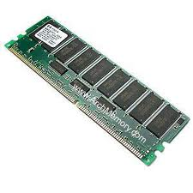
Account Profiles and Customer Data
Best
of the
Best
The best of the best know that understanding the complex customers they work with
  Can’t be left to ____________
  And good intentions
Strategy begins with good information

Slide 33
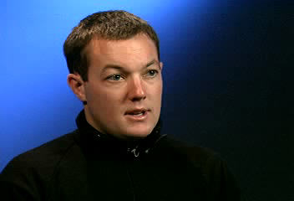
Customer Information

Slide 34
Account Profiles and Customer Data
Best
of the
Best
The best of the best write down specific ______________ about their customers
  Not to avoid making calls
  But to keep track of details
    Contact information
    Customer history and goals
    Decision processes
    Preferences

Slide 35
Account Profiles and Customer Data
Best
of the
Best
Many companies today have formal Customer Relationship Management or CRM systems
The best of the best use these not because their company requires it
  But because they know it helps them ______________
    It helps them find opportunities
    It helps them stay organized
    It helps them plan more effectively

Slide 36
Call Plans

Slide 37
Call Plans
Best
of the
Best
Call plans have been discussed from a strategic perspective
Tactically, call plans include:
  A clear, ____________ purpose or objective
    Not necessarily financial or dollar goals
  Logistics for the call
    Where, when, who
  Discovery goals
    What questions and information needed

Slide 38

Calls Must Be “Piloted”

Slide 39
Call Plans
Best
of the
Best
Call plans should be written
Should have an agenda that’s shared with the customer in advance
  It shows that you’ve planned
  They will take it more seriously
  Doesn’t have to be detailed
    Introduction
    Clarify challenges or goals
    Discuss potential solutions
    Next steps

Slide 40
Call Reports

Slide 41
Call Reports
Best
of the
Best
After each call, the best of the best will record some notes
  While it’s _________
  To make sure any promises made are fulfilled
Call reports are easily shared with others
  Helps to manage touchpoints
  Coordinates efforts across a team
  Shares what you’ve been doing with the boss!

Slide 42
Forecasting

Slide 43
Forecasting
Best
of the
Best
Forecasting is partly art and partly science
Important for organizational planning
  Inventory management
  ____________
  In public companies, signaling the marketplace
Should be realistic, but not sandbagged

Slide 44
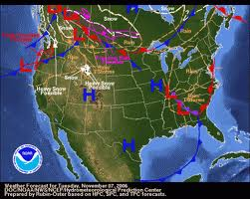
Forecasting (Extended)
Best
of the
Best
Best
of the
Best
Salesperson capability and internal issues also affect forecasts
  Company organizational changes
  New product launches
Longer timer horizons make forecasting accurately less likely

Slide 45
Forecasting (Extended)
Best
of the
Best
Best
of the
Best
Three basic tools for forecasting include:
  Subjective opinion estimates
  Extrapolation (relative to past years)
  Quantitative modeling
Regardless of which tool is used
  Accuracy should be reviewed
  _______________ should be made
    Throughout the period
    And at the end

Slide 46
Working Through Others

Slide 47

Managing Teams

Slide 48
Working through Others
Best
of the
Best
The best of the best recognize that they are on a team
  Often informally
  Often without authority
Different types of leadership can be used to motivate others
Transactional Transformational
(Dictatorial) (Developmental)

Slide 49
Leadership Styles
Best
of the
Best
Democratic Leaders- Invites other members of the team to contribute to the decision making process.
  This increases job satisfaction
  Particularly good with formal teams
______________Leaders- Allows colleagues to work autonomously.
  Good when followers are very experienced self-starters

Slide 50
Leadership Styles
Best
of the
Best
Servant Leaders- Driven by values and ideals – what is “right.”
  Often gains loyalty through sharing power
Charismatic Leaders- Use their likability to motivate others toward a common vision.
  Requires frequent personal contact

Slide 51

Visionary Leadership

Slide 52
Summary

Slide 53
Summary
The best of the best
  Use skills, business savvy and knowledge
  Prepare in advance for interactions
  Learn about customers needs and use tools to keep track of them
  Develop strategies to work intentionally
  Focus on revenue as well as customer satisfaction

