Slide 1
Marketing and its Relationship to Sales

Slide 2
Overview
Marketing versus Sales
Market Analysis
Marketing Objectives
Segmentation and Targeting
Market Planning
Action Steps and Metrics

Slide 3
Words to Watch
Vision
Mission
Environment
Target
Segment
Demographics
Psychographics

Slide 4
Words to Watch
Marketing Mix
Product
Pull Strategy
Distribution
Value Chain

Slide 5
Words to Watch
Bonus Words
Penetration Pricing
Skimming
Value Pricing
Promotions

Slide 6
Marketing Versus Sales

Slide 7
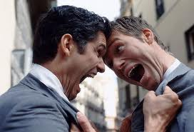
Sales and Marketing
These are not the same thing
But Sales and Marketing are not ___________
Photo courtesy ou.edu

Slide 8
Difference Between Sales” and “Marketing”
Marketing is a _____________concept
adapting and adjusting the total business to meet the changing needs of customers
Selling is a _______________concept
activities that get business
today
activity that pays the bills
and generates a positive
cash flow today!
Notes:
Marketing deals with the big picture -- what is going on in the marketplace and how you organize your resources to deal with those changes
Marketing deals with programs, policies, resources available (people, equipment, inventory, services) distribution, communications with customers, etc.
Marketing is setting goals and the plan for reaching it
Marketing operates within a time frame of months or years
Selling is a subset of marketing
Selling is what puts legs on marketing plan
Selling is face to face -- belly to belly
Selling is deciding how many calls to make today, who to call on today and tomorrow, what to talk about on the sales call
Selling is generating sales dollars to meet budget
Selling operates within a time frame of minuets and days
Must help dealer understand and become both better sellers and marketers
Marketing greatly enhances good selling . . .
. . . make good selling great!

Slide 9
Difference Between Sales” and “Marketing”
Marketing looks at customers _____________ _________________
Sales looks at customers one by one
Notes:
Marketing deals with the big picture -- what is going on in the marketplace and how you organize your resources to deal with those changes
Marketing deals with programs, policies, resources available (people, equipment, inventory, services) distribution, communications with customers, etc.
Marketing is setting goals and the plan for reaching it
Marketing operates within a time frame of months or years
Selling is a subset of marketing
Selling is what puts legs on marketing plan
Selling is face to face -- belly to belly
Selling is deciding how many calls to make today, who to call on today and tomorrow, what to talk about on the sales call
Selling is generating sales dollars to meet budget
Selling operates within a time frame of minuets and days
Must help dealer understand and become both better sellers and marketers
Marketing greatly enhances good selling . . .
. . . make good selling great!

Slide 10
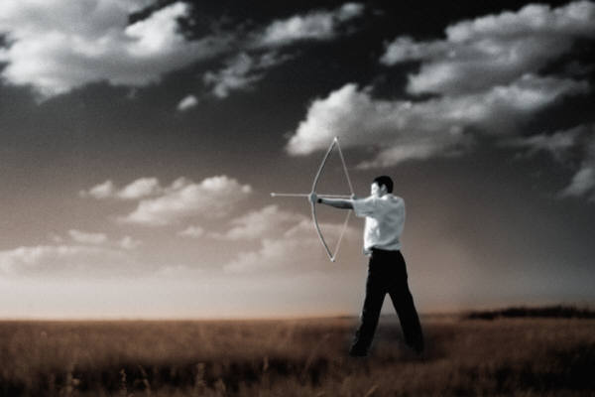
A working definition of marketing…
_____________
needs and wants
to manage the process
of satisfying customers
profitably
Developed by Purdue University
Notes:
Key Words . . .
• Anticipating
• Needs And Wants
• Targeted Customers
• Management Process
• Customer Satisfaction
• Profitability
Good Marketers know
what a customers needs are
before the customer Knows

Slide 11
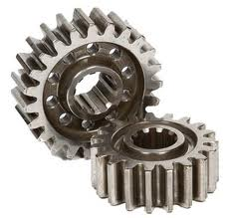
Innovation
The sales area should help anticipate needs and wants
Often hears first hand about satisfaction
And understands customer profits better than any other part of the company
WE ARE THE ________OF THE CUSTOMER!
Photo Courtesy Ashokagears.net

Slide 12
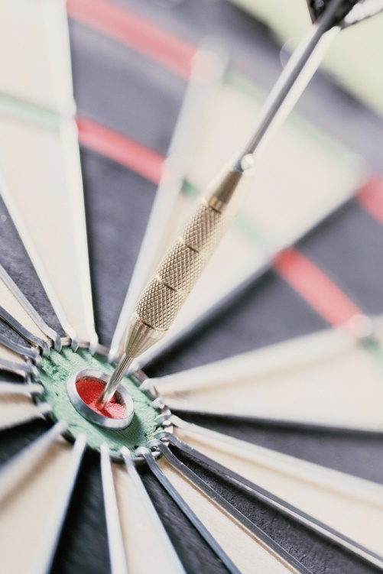
Marketing Defined
Marketing decisions are made in every area that touches the customer
Marketing determines the segments of customers who respond similarly to offers
Marketing defines which customer segments will be targeted
Marketing responds to the company environment

Slide 13
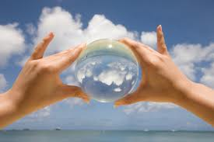
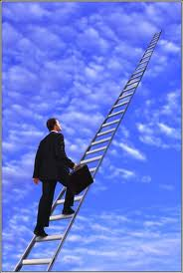
What Do We Stand For?
Company Mission:
Who do we DO in pursuit of our Vision?
Company Vision:
Who do we WANT our company to be?

Slide 14
A Brief Introduction to Strategy
Future
Resources
Present
Notes:
Strategy starts with decisions of what we want the future to look like. Then we determine how we compare on those things today. And then choose how to use our resources to get to the desired future.

Slide 15
Marketing Plans
Market Analysis Marketing Objectives Segment and Target
Market Mix Strategies
product
price
distribution
promotion, including sales
people
Action Plans Measure Results
Notes:
Market Planning starts with the same strategy approach. Based on the company’s mission and vision, we then assess where we are today and determine what future marketing objectives we want to meet in terms of metrics and with which customers. We then use our resources (marketing mix) over time (action plans) to try to reach our objectives. As we travel down the path, we measure results.

Slide 16
Market Analysis

Slide 17
Marketing Environment
Company
Technology
Social
Economic
Competitor
Political

Slide 18
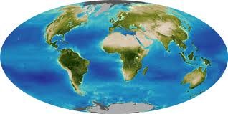
Economic Situation
Closely intertwined with politics
Global and local
Support and tariffs
Commodity prices
_______________________
Consumer spending
Availability of Capital and Interest rates
Currency and Exchange rates

Slide 19
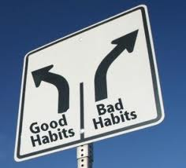
Social Trends
Demographics
Ages
Education
Gender
______________________
Attitudes and Opinions
Motivations
Behaviors, Habits, or Lifestyle

Slide 20
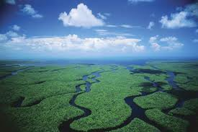
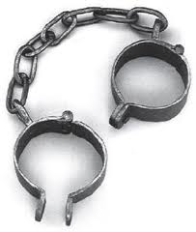
Political and Regulatory Issues
EPA
FDA
USDA
IRS
FAA
Others

Slide 21
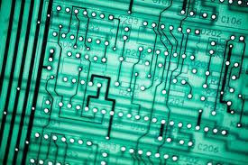
Technology
________________
Product Development
Production Automation
Process Improvements
Logistics
Knowledge Systems

Slide 22
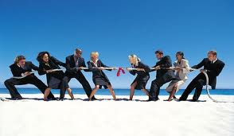
Competition
Examine all the factors in their marketing mix
Price, Place, Product, Promotion, People
____________________

Slide 23
Analysis
A company must also consider it’s own strengths and weaknesses, as well as the external opportunities and threats.
Combined, these are often referred to as _______________ analyses.

Slide 24
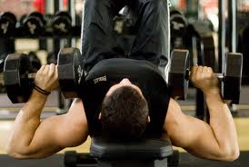
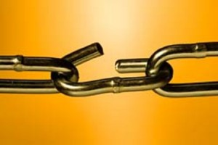
Examples of Strengths
Product performance
________________
Image
Examples of Weaknesses
Delivery
Billing
Limited offering

Slide 25
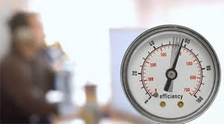
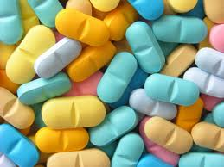
Examples of Opportunities
Buyers moving into your area
Competitors leaving
Achieving higher efficiency
Examples of Threats
A new competitor
Economic uncertainty
Products going ____________

Slide 26
Objectives

Slide 27
Objectives
Are the measurable components of the future desired state.
If the mission of the company were a box. The objectives would state ______________ _____________________ the box should be at some point in the future.

Slide 28
Objectives
Financial
Revenue
Cash
Gross Margin
_____________
Product Volume
Non-Financial
_______________
Customer Turnover
Concentration
Penetration
Product Mix

Slide 29
Segmentation and Targeting

Slide 30
Segment Characteristics
Measurable (Can you find out how many there are?)
Substantial (Is it big enough?)
Accessible (Can you __________ people in the segment?)
Differentiable (can you tell them apart?)
Actionable (Can you act on the differences?)

Slide 31
Targeting
Targeting or prioritizing some segments
does not mean that the general market is not important
To be most effective, programs and products
must be taken directly to those for whom they were targeted
Developed by Purdue University

Slide 32
An Example
Some marketers target specific segments based on their __________ or self-image.

Slide 33
Targeted Segments for Sales
In the example for Harley-Davidson, imagine if dealer sales people began to try to target a different segment
Buyers would be ______________
Money spent on advertising would be wasted
Sales would likely drop
Sales targets must be consistent with marketing targets

Slide 34
Market Planning

Slide 35
Marketing Mix
The Marketing Mix is a set of
tools used to accomplish
marketing objectives:
Selecting Customers
Products
Prices
Places (Distribution)
Promotion
People
In response to the company’s internal and external ________________
Product
People
Target Customer
Price
Place
Promotion

Slide 36
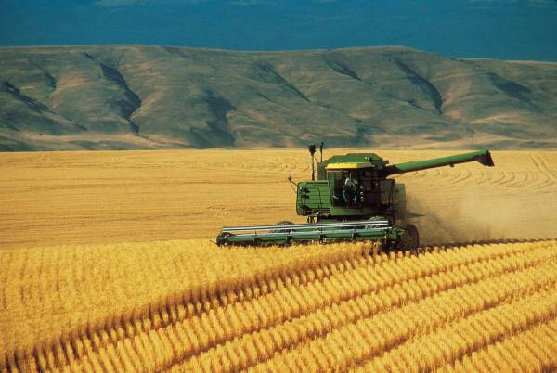
Products
The tools marketers use with products include:
Products
Services
Information
Often marketers seek to penetrate a market by selling more products to existing customers, which is often referred to as _____________

Slide 37
Products
Products may create two types of ________:
Tangible Value
Easily measured, see, touch, feel
Intangible Value
Reputation
Brand
Reduced time or convenience

Slide 38
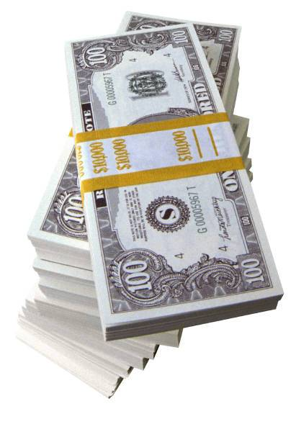
Pricing
Price is the only part of the
marketing mix that generates
revenue
Too low won’t cover costs
Too high will discourage customers
Sometimes the salesperson or sales department has ___________ to adjust price

Slide 39
Several Methods for Determining Price
Mark-up (or cost-plus) pricing adds a set amount or percentage to the cost of the product.
_____________ pricing match competitors
Target margin pricing sets prices to achieve a set profit percentage.
ROI pricing sets price so that projected sales volumes will achieve company profitability goals.

Slide 40
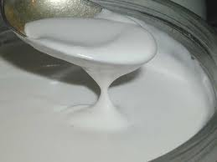
Pricing
Value-based pricing is based on willingness to pay rather than production cost
______________– new products enter the market at a low price in order to obtain market share quickly.
Skim pricing -- new product
prices are initially set high
so as to capture margin
from early buyers.

Slide 41
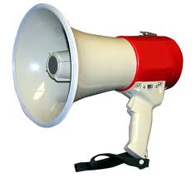
Promotion
Promotion is the process of informing people about your company or products
It includes message and media choices
Selling is just one ________________, and is an expensive way to get a message to customers, but can be effective
Messages from the sales force should be consistent with the company’s overall promotional messages

Slide 42
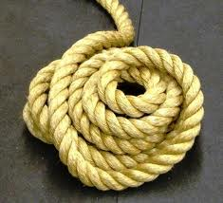
Promotion
Two common strategies of
Promotion include Push
and Pull
Push strategies “push” the product through the _________ by encouraging distributors to sell it.
Pull strategies “pull” the product through the channel by encouraging consumers or end users to demand it.

Slide 43
Promotional Tools
direct mail | training seminars | webpage
text updates | samples | brochures
trade shows | press releases | knowledge bases
newsletters | advertising | gifts
sponsorships | industry activities | purchase incentives

Slide 44
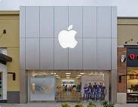
Distribution
Distribution is the “Place” P of the marketing mix.
This includes simple things like store hours and ____________

Slide 45
Other Components of Distribution
Formulating (to provide product in the right sizes and containers)
Shipping
Warehousing inventory
Tracking/billing for product shipped
Customer service
Coordinating ____________

Slide 46
People
There are several objectives of the People component of the marketing mix
Making sure people are aligned around a message
Making sure they have the talents and skills needed
Making sure they know targeted segments
Reinforcing their role as points of difference from competitors

Slide 47
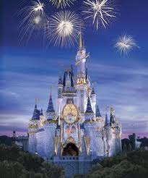
Marketing Mix
An Example:
Disney World
Product
People
Target Customer
Price
Place
Promotion

Slide 48
Marketing Mix
An Example:
Disney World
Entertainment Experience
Castmembers
Families
364 Days/Year?
$100 per person
WOM, TV Ads, Selling

Slide 49
Action Plans and Metrics

Slide 50
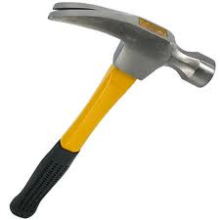
Action Steps
Action steps are specific tactics required to reach objectives with specific customer segments
Marketers must determine
Which tool to use where
And when

Slide 51
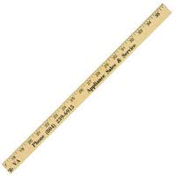
Metrics
Metrics are different than objectives in that the metrics are ________, used to measure the “box” of objectives.

Slide 52
Metrics
Sales people may be asked to track performance and ____________ metrics
Information flow about customers may be tracked in automated systems.
Marketing objectives should be monitored and measured throughout the period instead of _________________.

Slide 53
Summary

Slide 54
Sales
Marketing
Customers
Sales success is dependent on marketing strategies and customer needs.
Marketing success is dependent on sales efforts and fulfilling customers’ needs.
Satisfaction of customers’ needs is dependent on ________ sales efforts and marketing strategies

Slide 55
Summary
Marketing is a long term strategy
Marketing looks at customers in groups
Marketers accomplish the company’s mission through analyzing the internal and external environments and using marketing mix tools to bridge the gap between current and future states.

Slide 56
Summary
Sales people are one component of marketing and must work in a manner consistent with the company’s marketing plan

