Slide 1
Preparing to Sell

Slide 2
Strategy and Planning

Slide 3
Overview
Overview of Sales Strategy
Value Disciplines
Strategy at the Territory Level
At the Account Level
At the Sales Call Level

Slide 4
Words to Watch
Strategy
Territory Strategy
80-20 Rule
Differential Advantage
Status Quo
Gross Margins
Penetration
Concentration
Share of Wallet
Retention
Qualifying a Prospect

Slide 5
Overview of Sales Strategy

Slide 6
Strategy Defined
A strategy is a plan to assemble your resources
Skills
Knowledge
Energy
Time
People
In order to accomplish your objectives
Notes:
6

Slide 7
Review: A Brief Introduction to Strategy
Future
Resources
Present
Notes:
Strategy starts with decisions of what we want the future to look like. Then we determine how we compare on those things today. And then choose how to use our resources to get to the desired future.

Slide 8
Review: Marketing Plans
Market Analysis Marketing Objectives Segment and Target
Market Mix Strategies
product
price
distribution
promotion, including sales
people
Action Plans Measure Results

Slide 9
Strategy is Developed at Many Levels
Company Strategy
Territory
Account
Marketing
Call
Sales
Promotion
Sales
__________ is
only one part
of a company’s promotional strategy
Advertising, Public Relations would also have strategies
Each
component
of the marketing
mix has it’s own strategy: Price, Distribution, People and Product

Slide 10
Strategy
Sales professionals should coordinate their efforts with the broader strategic initiatives inside their company
Sales may be a ____________ of marketing strategy
But salespeople also create strategies of their own.

Slide 11
Strategy

Slide 12
Sales Strategy
Sales strategy begins with asking questions to understand your own company’s ____________
This includes questions about the marketing mix, but most importantly about targeted segments

Slide 13
Sales Strategy
Some questions to ask include:
Which types of customers do we most want?
How do we identify those customers?
What are those customers’ needs?
What special advantages do we offer these customers (relative to competition)?
Salespeople usually must take ____________to answer these questions as they are often not provide explicitly by the employer.

Slide 14
Value Disciplines

Slide 15
Strategy at the Sales Level
Marketing strategy drives decisions like:
how many customers a salesperson serves
which products should be ____________
How products should be priced
What messages should be delivered
Sometimes the marketing messages aren’t easy for a sales manage to determine
A simple way to understand them is to draw out the _______________

Slide 16
Product
Leadership
Value Disciplines Map
Best Product
Performance
Threshold
Leadership
Cost
Leadership
Customer
Intimacy
Best Total Cost
Best Match to Customer

Slide 17
Value Disciplines
Companies can’t be all things to all people, so must choose the areas in which they want to ________ versus meeting minimum customer satisfaction levels.
The sales department should direct each territory manager to emphasize the value disciplines that align with the company’s marketing messages and performance

Slide 18
Strategy at the Territory Level

Slide 19
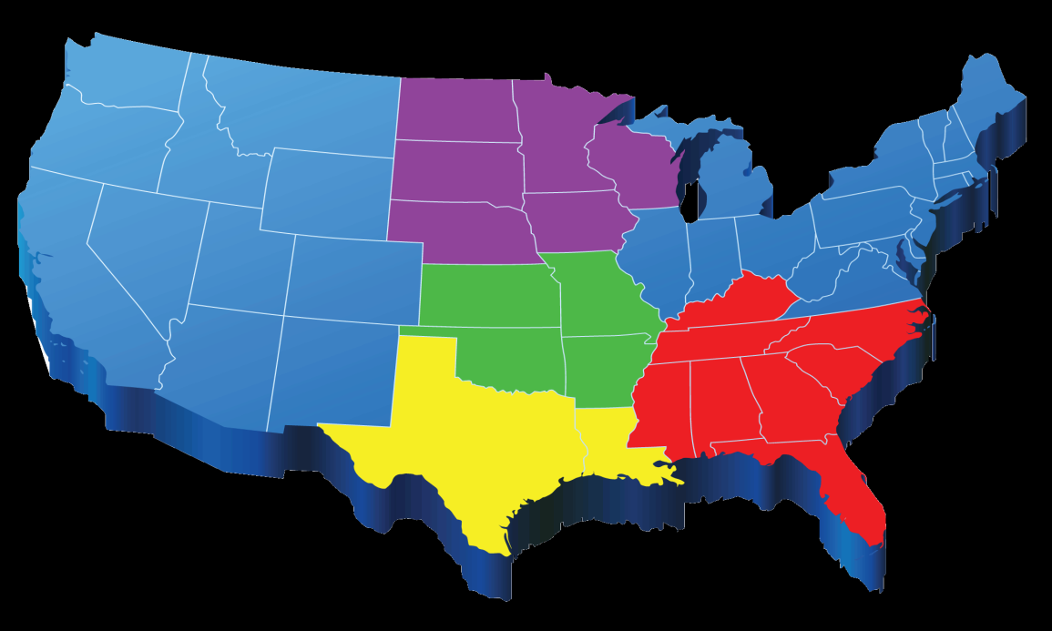
Territory Strategy
A territory strategy is used to accomplish the goals within a specific territory
“Territory” does not refer only to geography.
Product lines
Segment specialties

Slide 20
Targeted Customers
Marketers segment groups
Sales Departments focus on specific opportunities within those groups
Territory Managers ___________________to specific customer opportunities

Slide 21
Territory Segmentation
Defining opportunities within a territory means:
Competitive analysis
Analysis of unique needs of segments that exist within the territory
Determine which parts of your value offering are unique
Match unique value with customer needs
Those customers who are most likely to have needs that match that value become high priority segments.

Slide 22
High Priority Opportunities…
…Best help meet sales objectives for the ____________
Can be sold to profitably
Match the value offering of the company
Can be distinguished from lesser opportunities within the territory
The 80-20 rule, or pareto concept, states that 80% of business comes from 20% of the customers.
Salespeople are well advised to find that 20%!

Slide 23
Overview of Territory Strategy
Present
Analysis (Internal and External)
Talk to customers
Find out desired needs and benefits
Gather perceptions about
Best performing competitors
__________________
Confirm sales goals and _____________
Apply resources
Future

Slide 24
Types of Goals
Volume
Profit
Products
Penetration (Add new accounts)
Concentration
Share of Wallet
_____________

Slide 25
Goal Setting

Slide 26
Applying Resources
Lead with your strengths
Set the quality standard
If you can’t fix it – feature it
Emphasize your _____________

Slide 27
Applying Resources
Don’t waste resources on prospects who aren’t qualified!
Determine which customers to call on = Prospecting
Making sure those prospects have the authority and means to buy =
Qualifying

Slide 28
Strategy at the Account Level

Slide 29
Account Strategy
Once the opportunities within a territory are identified,
Each important opportunity should have its own strategy
Complete a review (at least annually)
Set goals that are focused on observable behaviors
Determine how resources will be allocated to achieve them

Slide 30
Strategy at the Sales Call Level

Slide 31
Sales Calls
The primary resource available to salespeople is ________ – in the form of a sales call

Slide 32
Call Strategy
Where does the relationship stand today?
Where do you want it to be by the end of the call?
Revenue
Behavior
Information
Relationship
How will you allocate time on the call to accomplish those changes?
An _______ Is a helpful tool to think about how time will be allocated on the call

Slide 33
A GAME Plan
A GAME plan for a call includes
________ for the call
An ________ of the actions to be taken
_________ to know if you were successful
_____________after the call to think about what you accomplished and plan the next step in the account strategy

Slide 34
Summary

Slide 35
Summary
Strategy is a plan for how to use resources to create a bridge between a current state and a future state.
It occurs throughout the organization
A territory strategy considers the best opportunities in a segment or geography
An account strategy allocates resources toward one relationship
A sales call considers activity during a call

