Slide 1
The Sales Process

Slide 2
Opening the Call

Slide 3
Overview
The Power of Relationships
Creating First Impressions
Greeting
Building Rapport
Types of Openings

Slide 4
Words to Watch
Opening
Impressions
Greeting
Eye Contact
Rapport
Neurolinguistic Programming
Kinesics
Mirroring
Transitioning
Standard Approach
Direct Approach

Slide 5
The Power of Relationships

Slide 6
Business Relationships
Business relationships are built on legal commitments to perform in certain ways that form the basis of _____________
But they are also built around personal commitments, trust, and liking
Buyers will rarely buy from someone they don’t _______, unless they have no other choice
Notes:
6

Slide 7
Relationship Stages
Relationships and trust grow over time
But begin with the first ______
And are critical at the beginning of every call
These “opening” activities include:
Creating a first impression
Greeting the customer
Building Rapport

Slide 8
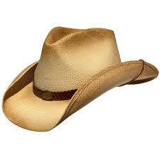
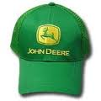
Building Relationships
Meet the basic expectation of any ______ relationship
Meet the “____________” of the business or person to whom you are selling
Meet the __________behavioral norms of the customer

Slide 9
Creating First Impressions

Slide 10
First Impressions
Notes:
10

Slide 11
First Impressions
Before any words are even spoken, we begin to form___________about other people
About how professional they are
Do they have an appointment?
Are they on time?
About how trustworthy they are
Do they appear “safe,” familiar?

Slide 12
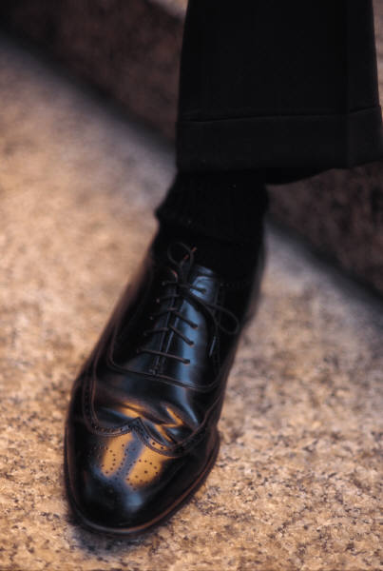
Creating an Impression
Their impression depends on
how you _______:
Your clothes should be…
Clean and well fitting
Fit the image
Appropriate shoes
Your grooming…
Hair trimmed neatly – slightly conservative
Nails clean and neat
Dress shoes should be polished.

Slide 13
Creating an Impression
__________ yourself carefully
If you have a question, choose the more conservative alternative
Your vehicle and briefcase or sales notebook should be clean, free of clutter, and in good repair.

Slide 14
Creating an Impression
_______________to:
How you ________
-a cloud of dust doesn’t cut it
-Watch for the kids and pets
Where you _______
-stay out of the yard
-don’t block anyone
What you are __________
-Look successful, but not rich
-Has the vehicle ever been washed?

Slide 15
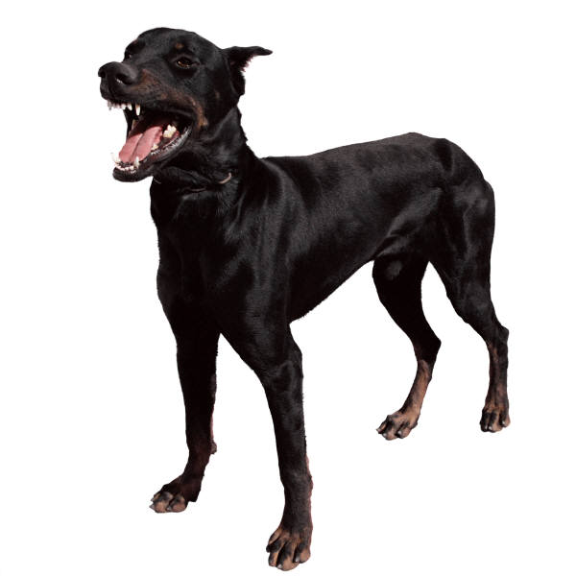
Creating an Impression
How you ________of your car
-with confidence
-but watch out for the dog
Where you ______
-Stay out of the barn or operating room unless invited
-Check at the house or office first

Slide 16
Creating an Impression
How you ______:
Don’t chew gum or tobacco
Don’t smoke
Don’t sit down unless invited …formally or by example
Don’t act too familiar
…Unless you know them well
Use ________________
Every circumstance is different

Slide 17
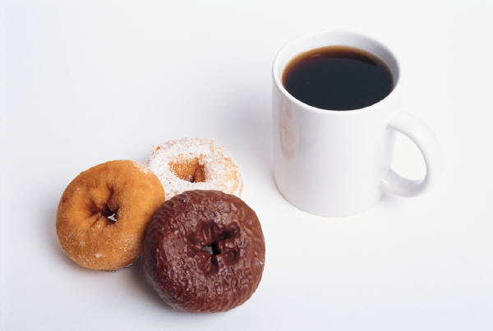
Creating an Impression
If offered a snack, be sure to:
___________after yourself
Don’t leave “cup rings” on their table
Don’t knock anything over

Slide 18
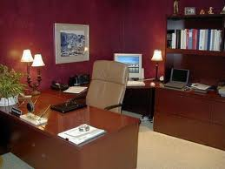
Creating an Impression
Take notes if you wish but _____________if it is sensitive
Always carry ______and notebook
Never move anything around without ________________
chairs,
papers,
or the desk

Slide 19
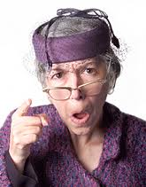
Creating an Impression
Seldom does anyone perceive themselves to be making a poor impression…
BUT OTHERS MIGHT!
IT IS WHAT THE __________ THINKS THAT COUNTS!

Slide 20
Greeting

Slide 21
The Greeting
A weak greeting makes you look weak
Be sincere
Being too pushy builds barriers
Have a greeting in mind
It’s OK to plan your opening line, but be flexible
Select a topic likely to be of interest to the prospect
Have your business cards handy

Slide 22
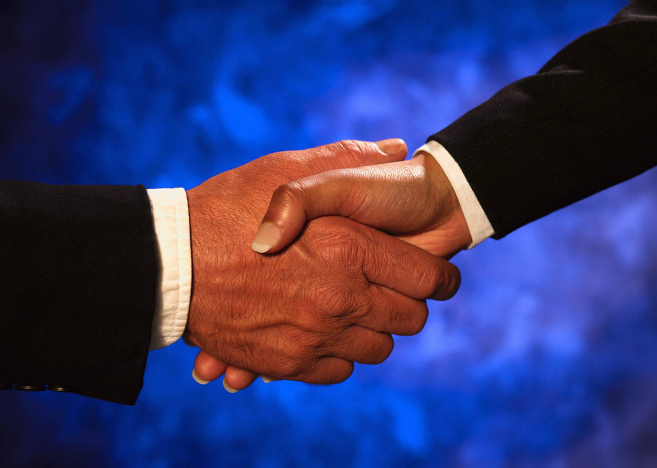
The Greeting
Approach the prospect confidently
With a smile
Offer a handshake
Firm – not ___________
“Go for the thumb”

Slide 23
The Greeting
Introduce yourself slowly and clearly
First name…(1,2,3) Last Name
Tell them what company you are with
And what you do

Slide 24
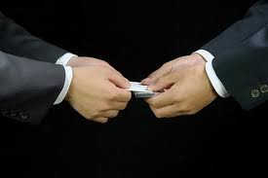
Business Cards
Have your cards handy
If you work internationally, have multiple languages

Slide 25
The Greeting
Pronounce the prospect’s name correctly
Repeat their name when introduced
Use titles unless you know them
Be careful using nicknames
Maintain _____________
Be courteous
Wear a nametag

Slide 26
Focus
At the same time you are greeting the prospect, you are receiving non-verbal signals that are critically important
__________the prospect
Re-evaluating your pre-call information

Slide 27
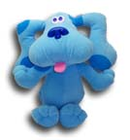
Focus
Look for ________
Search for areas in common
Examine the setting for things to discuss
Adjust your strategy
Select your best opening
On the spot ____________ are the rule

Slide 28
The Second Greeting
On a second meeting
____________them that you’ve met before, but Introduce yourself again,
Until they say, “Oh, you don’t have to introduce yourself to me.”
Make it easy and comfortable for them
Make doubly certain
to pronounce the prospect’s name correctly

Slide 29
Building Rapport

Slide 30
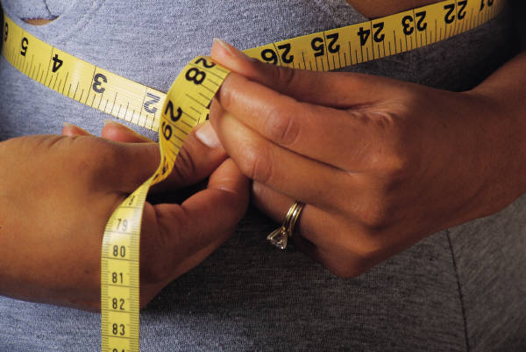
Building Rapport
Rapport-building serves the function of letting buyer and seller _____________.
The customer is also “taking your measure” to find out what king of person you are.

Slide 31
Building Rapport
Rapport-building looks like innocent, friendly conversation
To the well-trained, professional salesperson it is filled with opportunities to learn about the customer and what makes him/her “tick”

Slide 32
Building Rapport
Successful rapport builders adapt their style to the customer’s
___________ to a prospect’s style is not manipulative
but a skillful method of getting him or her talking about needs and priorities
It is a way of communicating more effectively with the customer -
based on the way they want to communicate

Slide 34
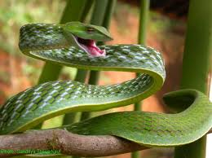
Building Rapport
Rapport building develops ________
because it shows the customer that you are not a threat
That you are genuinely interested in their business
Always confirm the schedule with them

Slide 35
Building Rapport
In the United States, small talk precedes business, even with high “D” customers
The customer should do most of the talking
If you talk too much, you may well miss the opportunity to know what is on your customer’s mind

Slide 36
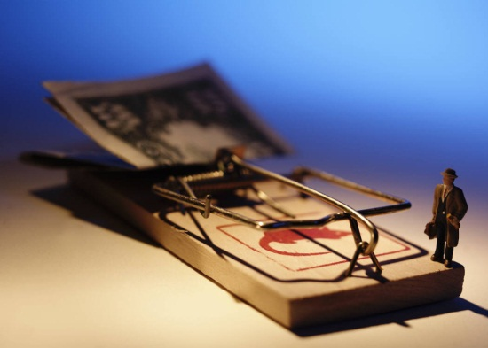
Building Rapport
It is good for the prospect to feel that ______ are in control of the conversation
Pace
Content
Length of each topic
When to move on
But in reality, it is the salesperson who directs the topics and flow of the conversation

Slide 37
Body Language
People often communicate through means other than words.
It’s why impressions are so important
People are less threatened by others who look and act like them.
Mirroring is the process of matching “kinesics” or body language
It occurs naturally and can be interpreted with training.
Notes:
37

Slide 38
Types of Openings

Slide 39
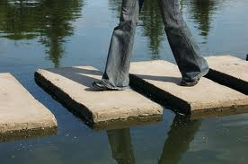
Transitioning
At some point, the conversation will need to move from rapport building to meaningful business conversations

Slide 40
Transitioning
Transitions are created with a bridge between small talk and the business conversation
These could be questions
Or statements that arouse the customer’s attention

Slide 41
Sales Call Openers
The two primary techniques for opening a sales call are the __________ approach and the ____________ approach
A standard approach simply raises a question or makes an observation that shifts the topic to business.

Slide 42
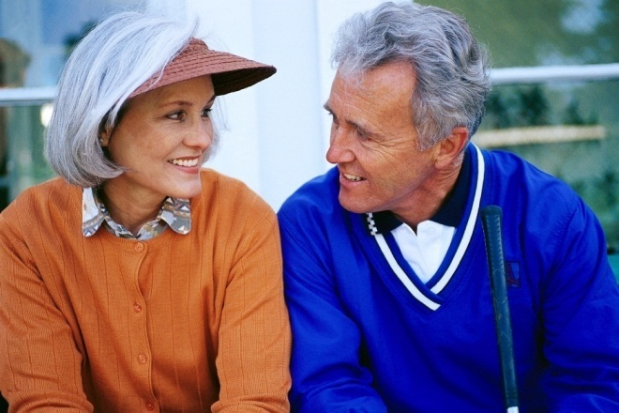
Sales Call Openers
The Standard Approach
Leads to general conversation
and areas of business interest
Looks like you’ve been pretty busy, lately.
How’s business been?
How are the crops doing?

Slide 43
Ice Breakers
An Icebreaker may be used to help with the transition
These are best when they can tie to a business objective
Gifts and trinkets
Samples
Headlines
Questions
Referrals and Testimonials

Slide 44
Icebreakers
“I wanted to stop by today to drop off some samples.”
We’ve been working on some new contracts to help deal with price volatility. Have you had any concerns about that recently?”
“Last week I was at Harry Armstrong’s practice and I had asked him who else he though might like to hear about our new dewormer. He gave me your name and said I should introduce myself to you.”

Slide 45
Icebreakers
A small but useful gift
May build good will
May obligate them for a few minute
Consider . . .
Caps, pencils, key chains, etc.
Copies of a relevant magazine article
Cold drink or coffee

Slide 46
Icebreakers
_______________them on something important
Powerful . . . If sincere
Sincerity is the key
Must be and sound natural
_________________designed to arouse interest and that will lead to further explanation
___________ - Suggest a mutual friend asked you to stop by, but be sure that is true

Slide 47
Icebreakers
____________ your product or provide samples that will get their attention
_______________-- Take something in a bag or box and just sit it there in front of them and don’t say what it is
Make sure it has a direct connection
Make sure it’s something useful, because it builds up in their minds

Slide 48
Mystery or Surprise Opening

Slide 49
Sales Call Openers
__________ Approach
Tell them exactly why you are there
Very honest
Doesn’t waste time
Doesn’t keep them wondering
Builds credibility
State your purpose in a way to get attention
Do not state your purpose in term of buying or selling but as a benefit to them

Slide 50
Sales Call Openers
The biggest drawback of the Direct Approach is that is often misses the opportunity to ______ about the customer:
“Bob, the reason I stopped by is to tell you about a new product/service we are introducing that I think can put more dollars in your pocket.”
It skips over the “business version” of rapport building in which the salesperson can learn more about what’s going on in the company

Slide 51
Summary

Slide 52
Summary
Whether calling on new prospects or established customers, the opening sets the tone for the call
Salespeople must present themselves in a way that puts the customer at ease
Most calls begin with some small talk, that looks like basic conversation to outsiders, but helps build trust and rapport
There are many techniques for transitioning to the business conversation

