Slide 1
Preparing to Sell

Slide 2
Understanding Customers

Slide 3
Overview
Why Do Customers buy?
The Hierarchy of Human Needs
The Buying Process
The Adoption of Technology
Opinion Leaders
Communication Styles
Transactional Analysis
Types of Buyers
Buying Situations

Slide 4
Words to Watch
Need
Hierarchy of Human Needs
Buying Process
Elaboration
Post Purchase Dissonance
Loyalty
Opinion Leaders
DISC

Slide 5
Words to Watch
Transactional Analysis
Nurturing Parent
Critical Parent
Stroke
Warm Fuzzy
Plastic Fuzzy
Cold Prickly

Slide 6
Why Do Customers Buy?

Slide 7
Buying
Wants versus Needs
Customers always examine the motivations for needs
A ______ is simply a gap between a current state and a desired state that a buyer has chosen to address

Slide 8
The Economic Exchange Model
When buyer’s make a specific purchase decision they believe they will gain more than they expect to give up
Customers also buy because of their ____________ and psychological needs
They may choose product because it brings “peace of mind” or enhances status
Notes:
8

Slide 9
The Hierarchy of Human Needs

Slide 10
The Hierarchy of Human Needs
Abraham Maslow suggests:
Human needs are arranged into a five-level hierarchy
With rare exceptions, the needs at one level must be met before the next level of need is ______________or becomes a motivational force
Notes:
10

Slide 11
The Hierarchy of Human Needs
Physiological needs
Self Esteem
Social Needs
Security
Self Actualization
Notes:
11

Slide 12
The Buying Process

Slide 13
The Buying Process
Need Recognition
Information Search
Examine Alternatives
Purchase Choice
Post Purchase Evaluation

Slide 14
Need Recognition
No purchase takes place until a problem or need is recognized
A change will bring improvement
Can be a real need, or just ____________

Slide 15
Information Search
Search for solutions or alternatives for a problem
Through media
Through friends and contacts
Through ______________________

Slide 16
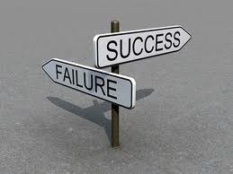
Examine Alternatives
How long the search will last or how many alternative will be considered depends on many factors
How much the item costs,
or the risk associated with the decision
dictates how much ____________ or conscious involvement in the purchase decision there will be.

Slide 17
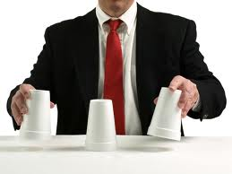
Examine Alternatives
Product and performance are important in the decision, but so are
The ______________________of the salesperson
Intangibles like brand and service
The reputation of the company
“Blind” evaluations of product performance are fairly rare

Slide 18
Choice

Slide 19
Choice
This may be a difficult process
Buyers may not feel comfortable _______________
May be a time of intense negotiations
Contract terms and conditions may play a role
Engineers may be involved in complex designs
Discussions may include finance, logistics, or product options.

Slide 20
Post-Purchase Evaluation
Strong desire to question the decision after it is made
To reinforce the opinion to purchase
Can result in delight or remorse
_______________ is a gap between expected and actual results

Slide 21
Loyalty
Desire to continue or repeat the purchase process
Benefits of loyalty are
Greater ___________ for mistakes
Higher potential margins
Can be transactional – habits of location or product
Or can be emotional – connection to the intangibles

Slide 22
The Buying and Selling Cycles
Buying often occurs in cycles
--seasonal, __________l
If you are selling to a business,
you must organize your selling cycle around their business buying cycle
The selling cycle must be
adjusted so customers are fully aware
of the right information
at the right time
Developed by Purdue University
Notes:
22

Slide 23
The Selling Cycle
Step 1: Need Recognition | Help the customer identify and define their need
Step 2: Information Search | Provide information that helps the customer identify the criteria for making a good decision
Step 3: Examine Alternatives | Show the customer the benefits of the salesperson’s solution compared to others
Step 4: Choose | Provide contracts, terms, and packages that make it easy for the customer to buy
Step 5: Post-Purchase Evaluation | Follow up with the customer to ensure actual benefits at least match expected benefits

Slide 24
The Adoption of Technology

Slide 25
Adoptions of Innovation
Customers have different levels of comfort with change.
A landmark study by Everett Rodgers looked at adoption of ___________________in the ag industry.
Notes:
25

Slide 26
Notes:
26

Slide 27
Innovators (First 2.5% to adopt)
Anxious to try an untried brand or idea
______________
See themselves as in touch with new ideas
Frequently read research bulletins
Well educated
Have a scientific approach to problem solving
Able to deal with abstract ideas
Notes:
27

Slide 28
Early Adopter (Next 13.5% to adopt)
Willing to try a new idea or technology
Not the very first to embrace a new product or idea
Refer to themselves as “one of the first”
Well _______________
Stay up to date with company meetings and trade publications
Notes:
28

Slide 29
Early Majority (Next 34% to adopt)
Willing to try a new idea or technology
When there is enough evidence for them, they jump aboard the ship too
___________ - oriented people
Many contacts in the
community
Notes:
29

Slide 30
Late Majority (Next 34% to adopt)
Have a wait-and-see attitude
Are often ___________ about new ideas
Tend to be less well educated
Less well-read
Smaller farms or businesses
Rely more on friends and neighbors for info
Travel outside community less
Notes:
30

Slide 31
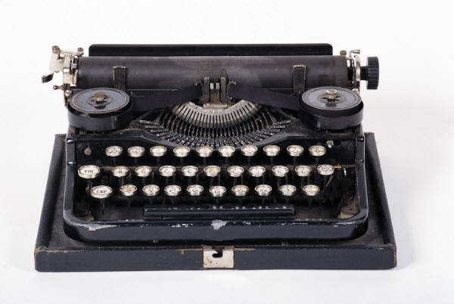
Laggards (Last 16% to adopt)
Least progressive, averse to taking risks
Less educated
Afraid of debt
Rarely in leadership role
Less well read
Rely on friends and neighbors
Not heavily involved with community groups
Notes:
31

Slide 32
Opinion Leaders

Slide 33
The Power of Opinion Leaders
An opinion leader is a customer (or potential customer) who is _____________ by his or her peers for business success.
Other potential customers watch the opinion leader and often try to emulate his/her decisions
They are found on the boards of directors of industry organizations, cooperatives, school boards, and churches
Notes:
33

Slide 34
Opinion Leaders
It is easy to find opinion leaders, but it’s not easy to sell to them
Many salespeople call on them
They may not be ___________ easily
Usually curious about better ways to do things and sometimes seek out information on their own
They seem to revel in adopting good new ideas, so it may not be necessary to offer special rewards or deals
Notes:
34

Slide 35
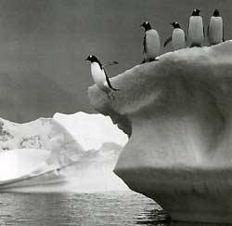
Opinion Leaders
It is a good idea for the salesperson to develop a strong relationship with opinion leaders
Can bring salesperson a sizable amount of business themselves
May prove helpful as a source of extremely powerful testimonials
They can also have a negative influence
Notes:
35

Slide 36
Communication Styles

Slide 37
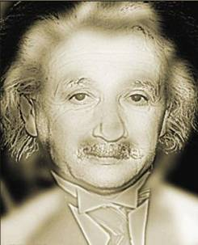
Behavioral Styles
One way to understand customers is to examine their behavior.
Dr. Russ Watson developed the ______ profiling system that categorizes behavioral styles along four dimensions
Looks can sometimes be deceiving
Notes:
37

Slide 38
Communication Styles - DISC
Dominance | How the customer deals with problems and challenges
Influence | How the customer relates to people and tries to influence others
Steadiness | How the customer deals with change and activity
Compliance | How the customer deals with rules set by others

Slide 39
Behavioral Styles
Each of us is a ______ of all four types of behavior, as is each customer
However, each individual tends to have one “primary” behavioral style
Notes:
39

Slide 40
Behavioral Styles
__________ describes an individual’s approach to getting results and solving problems
High dominance people
want to solve problems quickly and directly
Low dominance people
tend to solve problems in a more controlled and calculated way
Notes:
40

Slide 41
Behavioral Styles
___________ describes a person’s approach to people and emotions
High influence people tend to be outgoing and socially assertive
Low influence people are quiet and reserved
Notes:
41

Slide 42
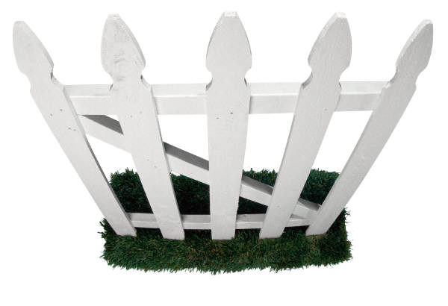
Behavioral Styles
______________ describes the preferred pace
each person follows in their social and
work environment
High steadiness people prefer a more controlled and predictable environment
Low steadiness people represent the classic “don’t fence me in” type
Notes:
42

Slide 43
Behavioral Styles
_____________ describes a person’s ability to be comfortable with rules
High compliance people
Have no problem sticking to “the rules”
Expect others to abide by them as well
Low compliance people
Like to work independently
See rules as guidelines
Notes:
43

Slide 44
Recognizing Behavioral Styles
Sellers can look at the behaviors of their potential clients to determine which style they tend to act on.
Do they act in charge or bottom line oriented?
Are they chatty? Enthusiastic?
Are they polite and reserved, but talk with frustration about changes?
Do their eyes go to the “fine print” in brochures or do they frequently ask “how things work?”

Slide 45
Types of Buyers
Notes:
Note that in the flow of the text, Buyer types and buying situations come after transactional analysis. However, for many instructors transactional analysis will be a new topic (or an old one, as it was in early versions of the Agriselling text). And its inclusion within this slide set probably makes the discussion on this chapter beyond appropriate conclusion in a single class period. TA makes a nice discussion on its own, and presents the possibility for some fun interactions and roleplays. Therefore, it is moved to the end of this slide set.

Slide 46
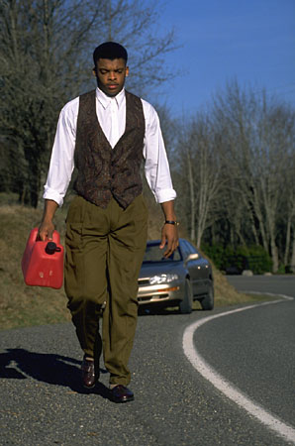
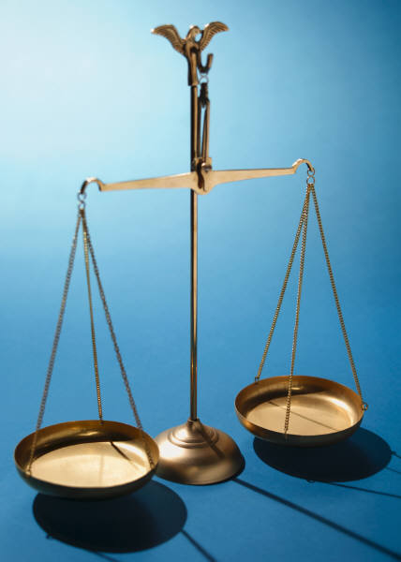
Three Types of Buyers
Buying decisions are dependent on the primary motivation for making purchases.
Relationship
Economic
Business
Notes:
46

Slide 47
Three Types of Buyers
It is through determining the customer’s predominant __________that you can better understand how that customer will likely evaluate you products, services, programs and prices
The buyer type may be as important as the product or service itself
Notes:
47

Slide 48
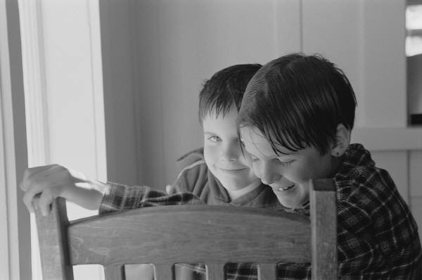
Three Types of Buyers
Buyer types are usually not _________to size of customer’s business
Relationship buyers may be large or small
All large buyers are not economic buyers
Notes:
48

Slide 49
Three Types of Buyers
Jim Ahlem
Frank Howey
Dave Anderson
Relationship
Economic
Business
Likes regular contact
Wants to ________
Trusts information sources they know
Likes informal and formal contact
Accepts rep, trust rep
May not compare price
Likes full-service
Always considers _____t
Likes to compare price
Reacts quickly
No interest in service
Competitive
Relies on own information sources
Pragmatic
Self-reliant
Brief, to the point
Likes
Facts and _________
Expertise
Organization
Appointments
Compares and evaluates value as a bundle
Notes:
49

Slide 50
Key Decision Preferences for Buyer Types
 | Relationship Buyers | Economic Buyers | Business Buyers
Information Search | Word of mouth (friends and neighbors) Trusted source is important factor | Extend information search when stakes are high Search for cost effective solution Pit one supplier against another | Extensive search if situation warrants it Examines how the solution impacts the bottom line
Weigh Alternatives | Ask opinions of their friends Listen to the advice of trusted salesperson | Very careful to get the best deal | Weighs many factors - both economic and personal May associate worth with each attribute to determine the best overall value
Choose | Make decision quickly -- no need to drag it out | May move quickly for a deal May respond to price terms | Often consider loyalty Usually plans ahead
Notes:
50

Slide 51
Buying Situations

Slide 52
Types of Buying Decisions
 | New Task | Modified Rebuy | Straight Rebuy
Customer Needs | Info about causes and solutions for a new problem Reduce high risk | Information and solutions to increase efficiency | Generally already met
Number of buyers | Many | Few | One
Key decision makers | Executives/ engineers | Production & Procurement manager | Purchasing agent
Notes:
52

Slide 53
Types of Buying Decisions
 | New Task | Modified Rebuy | Straight Rebuy
“In” supplier | Monitor changes in customer needs Respond quickly Provide tech info | Act ASAP when problems occur | Reinforce relationship to make sure needs are met
“Out” supplier | Suggest new approaches Provide tech advice | Respond quicker New ideas to improve efficiency | Get recognized Get them to re-evaluate relationship
Notes:
53

Slide 54
Transactional Analysis

Slide 55
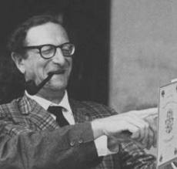
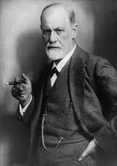
Transactional Analysis
Developed by Eric Berne, and popularized by Tom Harris in “I’m OK – You’re OK”
Influenced by________Id, Ego, Superego

Slide 56
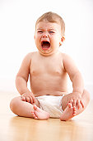
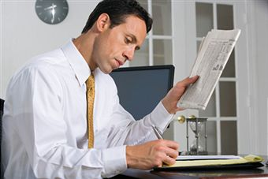
Transactional Analysis
Personality is made up of three parts:
Parent
Adult
Child

Slide 57
Parent
The parent is judgmental
Represents a person’s beliefs
The oughts
The shoulds
Evident in sayings that people hold to be true:
“A penny saved is a penny earned.”
Parent

Slide 58
Parent
A “Nurturing Parent” expresses sympathy
A “Critical Parent” is the voice that says, “You’re not good at that.” or “You should be better.”
Parent

Slide 59
Adult
The adult is __________logical, unemotional
This is the place where salespeople should spend time
Adult

Slide 60
Child
The child is the ________ part of us.
It is not logical or rational.
The child complains and cries, but it also expresses great joy and playfulness.
The child can also be fearful or sad.
Child

Slide 61
The Child State

Slide 62
Transactional Analysis and Behavior
Many people have combinations of these factors that they prefer to operate in, although that makes it sound intentional.
Ego states are usually unconscious choices about behavior
_____________ occurs when one ego state is so strong that it overwhelms and drives others.

Slide 63
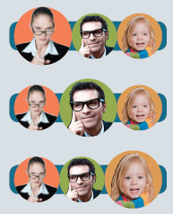
Ego Portraits
Ego portraits describe personalities by the relative proportion of each state in which someone “typically” acts

Slide 64
Transactions
We can use the portraits to describe the states people are in as they interact
“Your delivery guy cut the corner and ran over my wife’s prize azaleas!!”
“You guys should be more careful where you drive.”
“I’d like to discuss restitution for my wife’s azaleas.”

Slide 65
Transactions
Ego states can be observed in _______________
Parent and child states often interact with one another, and then can evolve into conflict between two child states.
1
2
3
4

Slide 66
Interactions
By staying in the adult, the parent or child can be defused.

Slide 67
Special Transactions
Strokes
______________
Super strokes – a warm fuzzy from someone you respect or care about
Plastic fuzzies – strings attached, “I’ll be your best friend if…”
Cotton candy strokes – “Have a nice day”
________________strokes – “I brought you a key chain”

Slide 68
Special Transactions
____________
Negative recognition
Often sarcastic or meant to sting
“You guys would be good, if you could get your price down.”
“Hey, I just wanted to tell you how bad your billing department is.”

Slide 69
Special Transactions
Listening
Eye contact
Touching (appropriately)
Pat on the back
Hand shake

Slide 70
Summary

Slide 71
Summary
There are many ways of understanding customers
People are complex and no one method of understanding them works
Taking time to understand the behavior and psychology that drives decisions can help a salesperson manage the relationships or the sales process more effectively.

